Slide 1



EMPLOYEE DATA ANAYSIS USING EXCEL
STUDENT NAME:MOHANA PRIYA P
NAAN MUDHALVAN ID:9263836186074668BFA4718A3A76D048
REGISTER NUMBER:422200497
DEPARTMENT:B.COM(ISM)
COLLEGE: VALLIAMMAL COLLEGE FOR WOMEN

Slide 2

Project title
EMPLOYEE PERFORMANCE ANALYSIS USING EXCEL

Slide 3

AGENDA
Problem statement
Project overview
End users
Our solution and proposition
Dataset description
Modelling approach
Results and discussion
Conclusion

Slide 4


PROBLEM STATEMENT
THIS ANALYSIS MADE TO CHECK WHETHER THE SALARY OF EMPLOYEES WAS INCREASED OR IT DOESN’T HAVE ANY INCREMENT.THIS DATASET HAS MANY FEATURES AMONG THAT I HAVE TAKEN SALARY HAS MY FEATURE.

Slide 5

Project overview
Analyse the salary of the employee by considering various factors of like Gender , Employee ID, Start date , Employee type , Department , etc.. We use these in order to identify the trends , patterns of different categories of employee Salary like very high , high , medium and low .

Slide 6


End users

Slide 7
Our solution and proposition
Conditional Formatting – Blank values.
Sort & Filter – Filter – Remove Blank Values.
Formula – Salary .
Pivot Table – Summary.
Graph – Data Visualization.

Slide 8
Dataset Description
Employee Dataset – Edunet Dashboard.
11 Features .
5 Features.
Employee ID – Numerical Values.
Name – Text.
Gender – Text.
Salary – Numerical Values.
Start Date – Numerical Values.

Slide 9
Modelling
DATA COLLECTION :
Naan mudhalvan .
Edu net Dashboard.
FEATURE SELECTION :
11 Features.
5 Features.
DATA CLEANING :
Colour blank values
Filter – Remove Blank Values

Slide 10
SALARY LEVEL :
Very High.
High.
Medium.
Low.
PIVOT TABLE :
Employee ID.
Name.
Gender.
Salary.
Salary level.

Slide 11
Start date.
Employee Type.
CHART :
Employee ID :
Name :
Gender :
Salary :
Salary Level :
Start Date :
Employee Type :
Data Visualization :

Slide 12
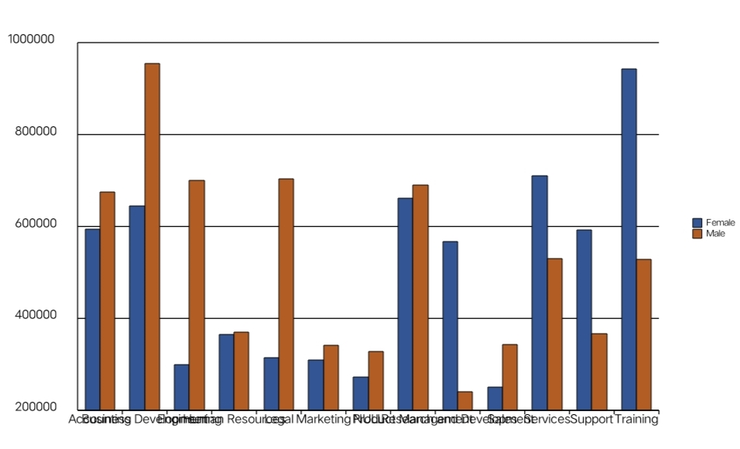
Result

Slide 13
CONCLUSION
While comparing the salary level of the employee , the employee’s are getting their salary according to their employee type and start date.

Slide 14
THANK YOU

